Slide 1
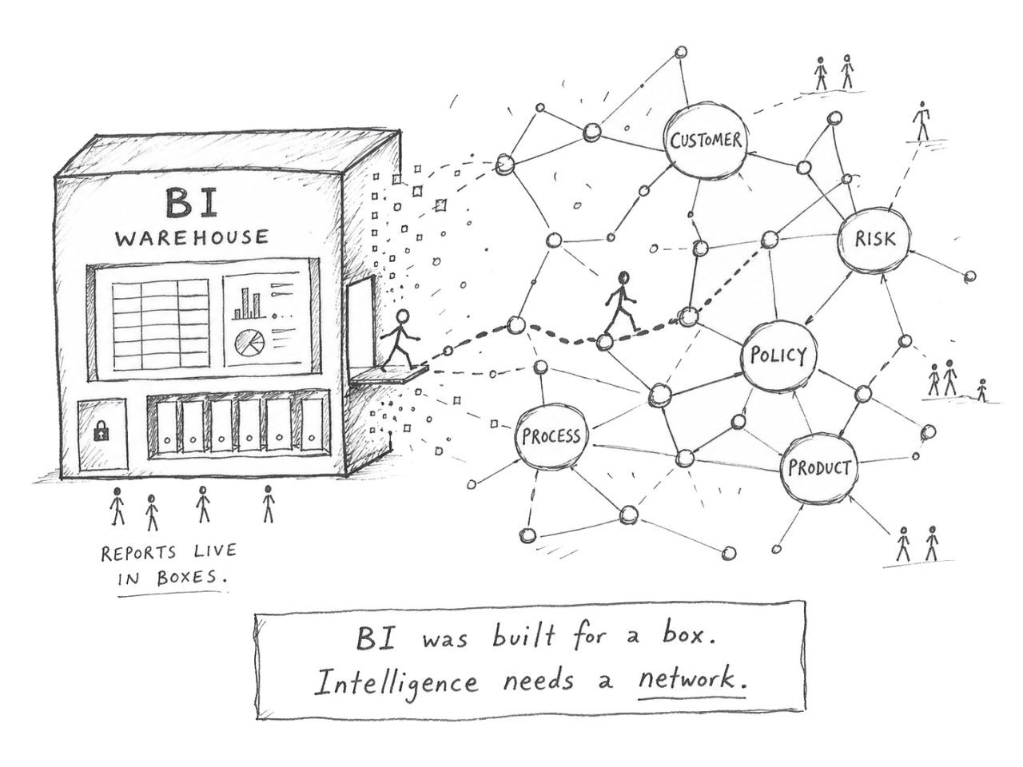
Where we are moving towards
BI was built for a box. Intelligence needs a network
From reports → decisions
Dashboards answer known questions. Decision intelligence helps users ask new questions, connects context, validates SQL and explains recommendations with evidence.
TRADITIONAL BI
Fixed report layer
• Predefined dashboards
• Predefined metrics
• Slow follow-up analysis
• Limited explanation
• Business logic hidden in reports
AI DECISION INTELLIGENCE
Dynamic question layer
• Role-aware questions
• SQL generated from verified schema
• Business context retrieved from pgvector
• Model scores and recommendations
• Evidence and lineage for trust
Notes:
---- You can buy the best model on the market. Give it tools, memory, a beautiful interface. Point it at fractured, siloed, contradictory enterprise data and it will reason flawlessly straight to the wrong answer.
--The analytics stack is shaped like a box. Rows, columns, tables. Clean rectangles, optimised for one job: aggregating the past into a report. It did that job well. --- But an agent does not ask for a report. It asks what relates to what. It follows chains of meaning across products, customers, risks, processes and policies - crossing the boundaries the warehouse kept apart. And a box cannot hold a chain. The moment intelligence needs relationships, the rectangle breaks. --- The age of AI is not box-shaped. It is network-shaped.

Slide 2
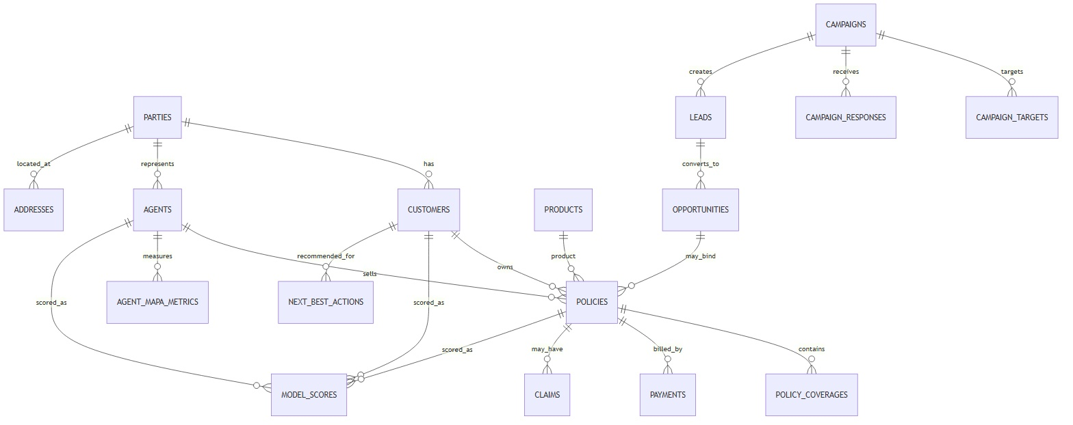
So how this came together
Step 1- Core Base Data Foundation
From reports → decisions
Step 2 – Build features and Model score , predictions and Semantic document on top of it

Slide 3
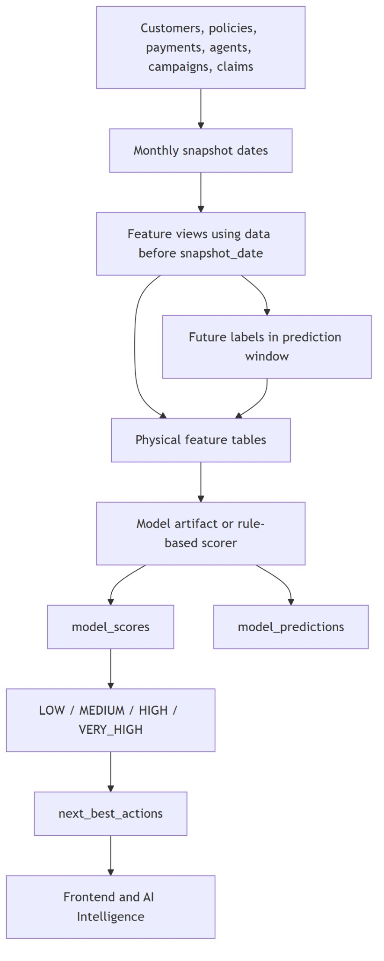
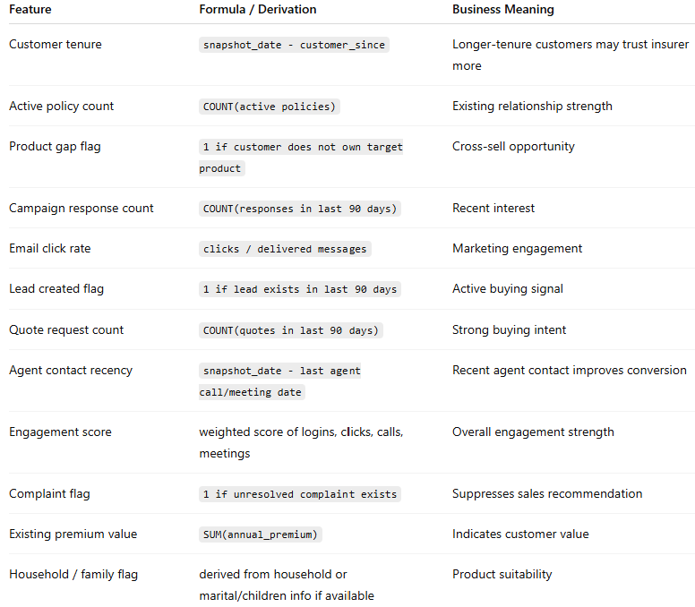
Feature and model layer
The models use customer, policy, campaign, payment, engagement, service, and agent interaction signals. In a production version, these same features would be trained and calibrated on the historical outcomes. So We need to timely refresh them
Campaign response
Lead conversion
Propensity to buy
Next best product
Open/click/respond/lead
Lead score, source, agent assignment
Engagement, product gap, past response
Existing holdings, segment, behavior
Prioritize responsive segments
Route best leads to senior agents
Create call lists by likelihood to buy
Recommend health rider or upgrade
Propensity to buy (Intent) : model estimates which customers are most likely to buy another product within a defined future window, such as the next 30, 60, or 90 days
Model outputs feed model_scores, model_predictions and next_best_actions
Define - Properties
Define -Signals
Calculation & labelling
Item | Definition
Model entity | Customer
Prediction | Prediction
Prediction window | Next 30 / 60 / 90 days
Label | 1 if customer purchases a new policy in prediction window, else 0
Output | Propensity score between 0 and 1
Stored in | model_scores, model_predictions
Propensity features are calculated using only data before the snapshot date.
Example:
snapshot_date = 2026-06-01
Features:
- campaign responses from 2026-03-01 to 2026-06-01
- policies active as of 2026-06-01
agent meetings before 2026-06-01
Label:
- did the customer buy a new product between 2026-06-01 and 2026-08-30?
Propensity Score =
0.25 × campaign engagement score
+ 0.20 × quote / lead activity score
+ 0.15 × product gap opportunity
+ 0.15 × customer value score
+ 0.10 × agent contact recency score
+ 0.10 × digital engagement score
- 0.05 × unresolved complaint penalty
Low
Medium
High
Propensity
In- production model is not a single hard-coded formula; it is a supervised classification model.
But conceptually, the propensity score is a weighted combination of buying signals
Notes:
Show how the feature layer feeds batch scoring, which writes scores and recommended actions. Use campaign response and lead conversion as concrete examples.
ScoreBand
0.00–0.30LOW
0.31–0.60MEDIUM
0.61–0.80HIGH
0.81–1.00VERY_HIGH

Slide 4
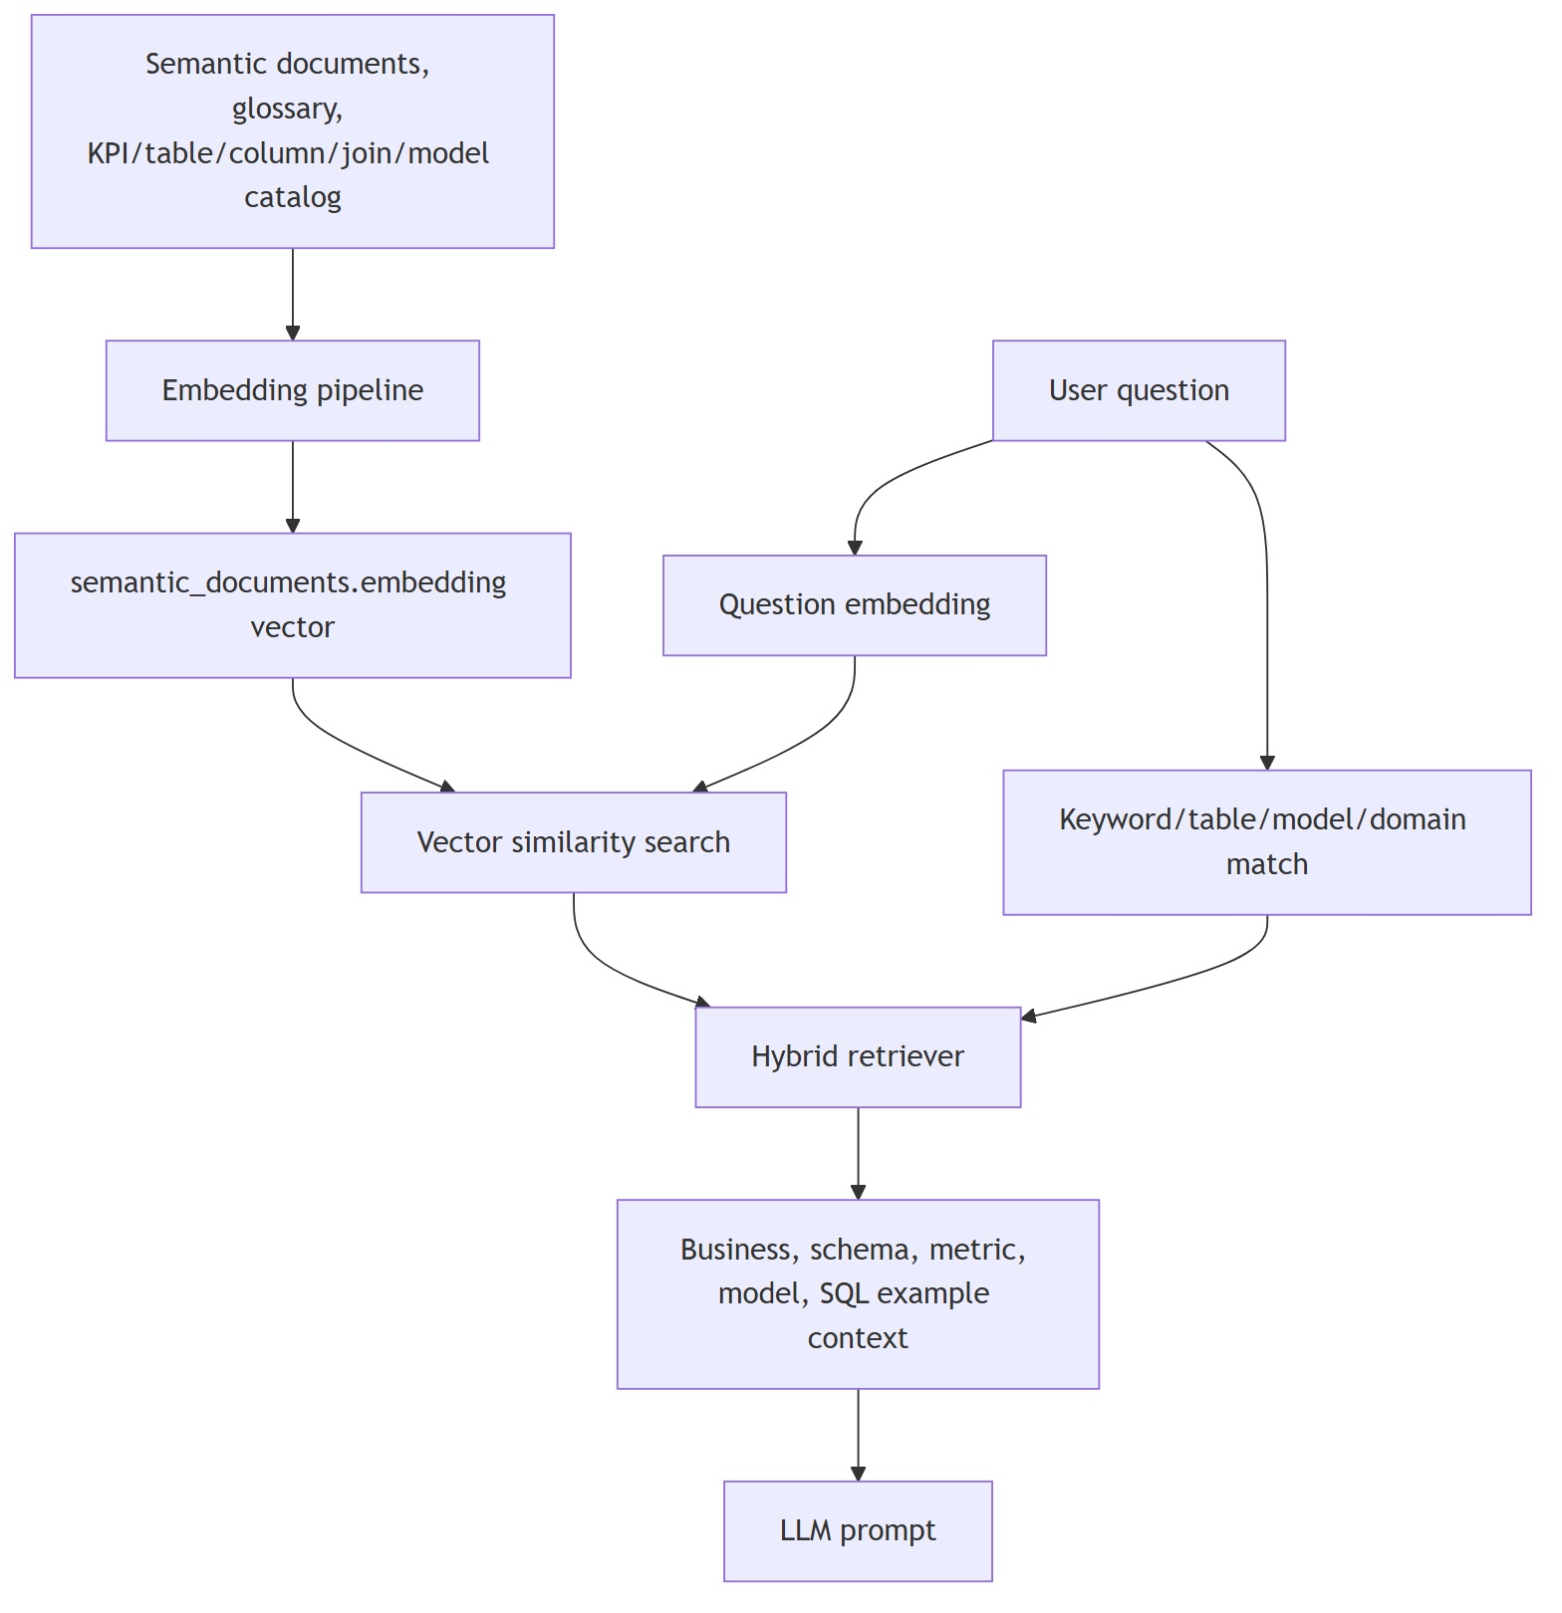
Semantic context and pgvector
Data still stays in SQL. But context or meaning is retrieved from vectors.
The vector store does not replace the database. It just stores business meaning so the LLM understands what to ask from the database.
CONTEXT EXAMPLES
• Campaign conversion definition
• Valid joins across campaign → lead → policy
• Model score interpretation
• KPI formula and grain
• SQL examples using real tables
• Missing data rules
Client briefing | 8
Notes:
This is the key AI explanation: pgvector stores semantic context, not facts. It retrieves table meanings, KPI definitions, model descriptions and join paths for SQL generation.

Slide 5
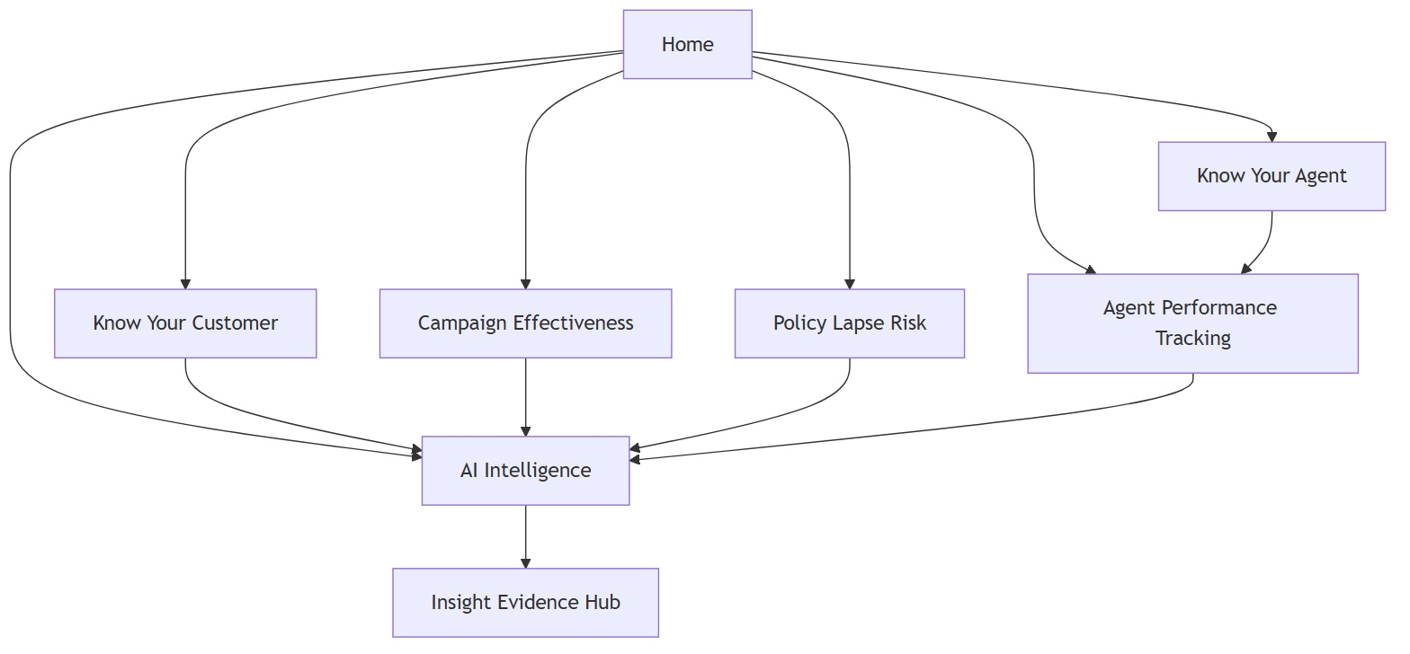
INSURANCE DECISION INTELLIGENCE PLATFORM
User experience
Insurance Intelligence Product
TAB-BY-TAB STORY
Every dashboard feeds the AI layer and the Evidence Hub
• Campaign Effectiveness shows the campaign funnel
• Agent Performance shows productivity and coaching needs
• Policy Lapse Risk identifies revenue at risk
• AI Intelligence answers open business questions
• Insight Evidence Hub explains why the answer is trusted
Dashboard → Ask → Evidence
Client briefing | 11
Synthetic insurance data • Supabase • pgvector • Gemini / LLM • Evidence Hub
Notes:
Explain that the user experience is not a collection of dashboards only. Dashboards are entry points into AI Intelligence, and Evidence Hub is the trust layer.

Slide 6
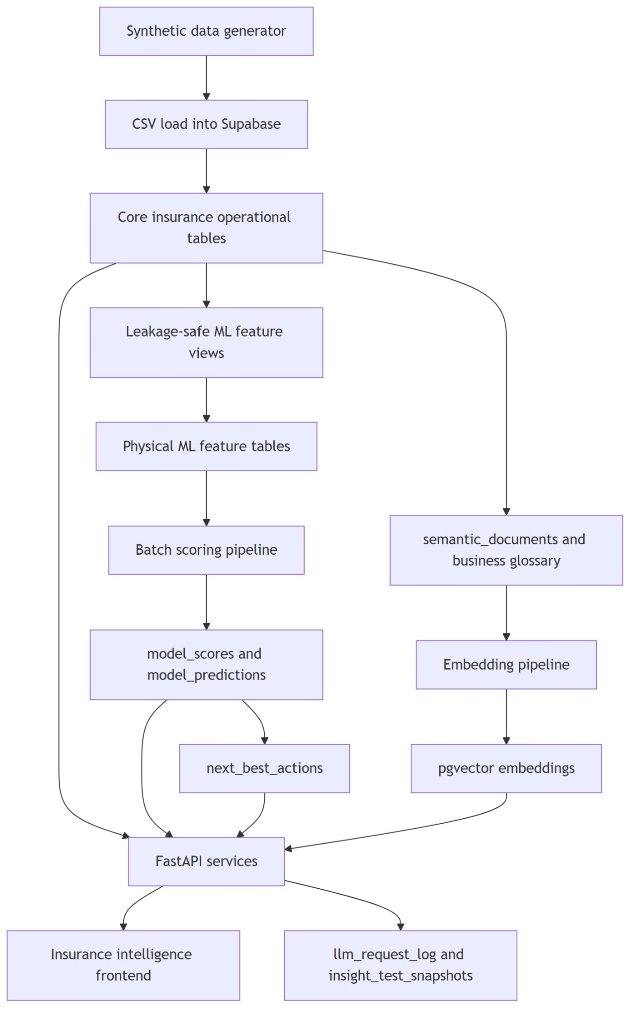
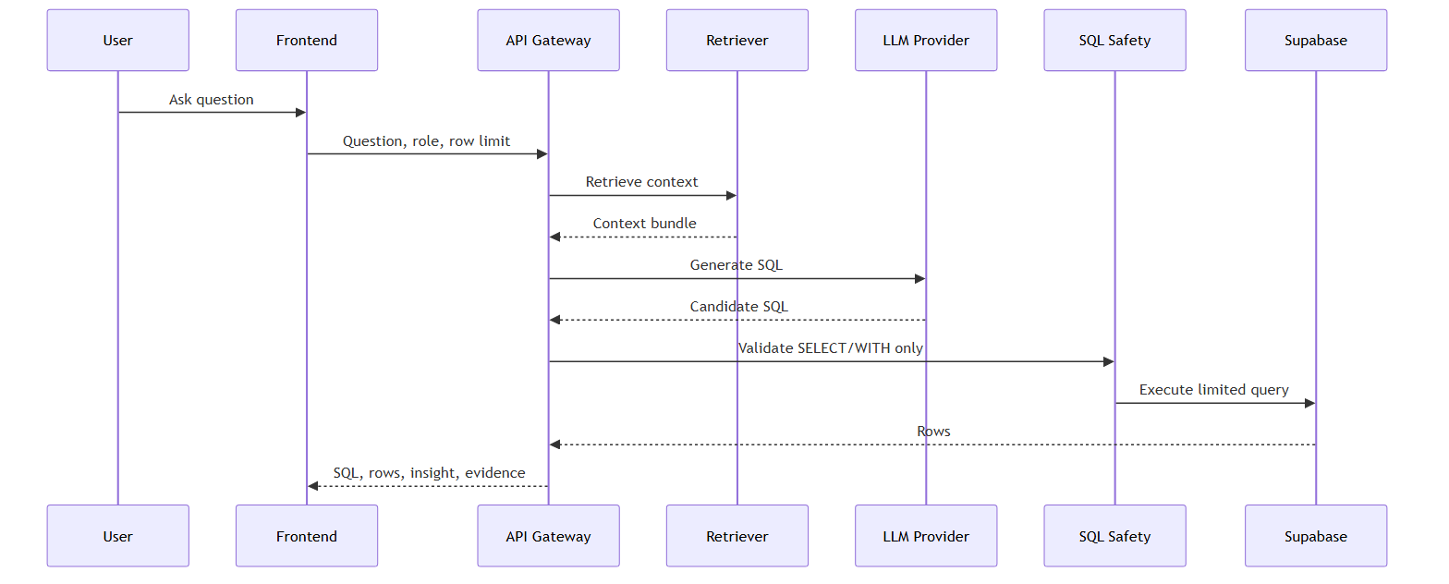
How the application flow happens
From reports → decisions
1
2
3
4
React / Next.js
FastAPI services
LLM provider
Supabase + pgvector
Orchestrates context retrieval, SQL generation, execution and evidence logging
Generates SQL and human business insights using retrieved context
Holds facts and semantic context embeddings
Role-aware frontend

Slide 7
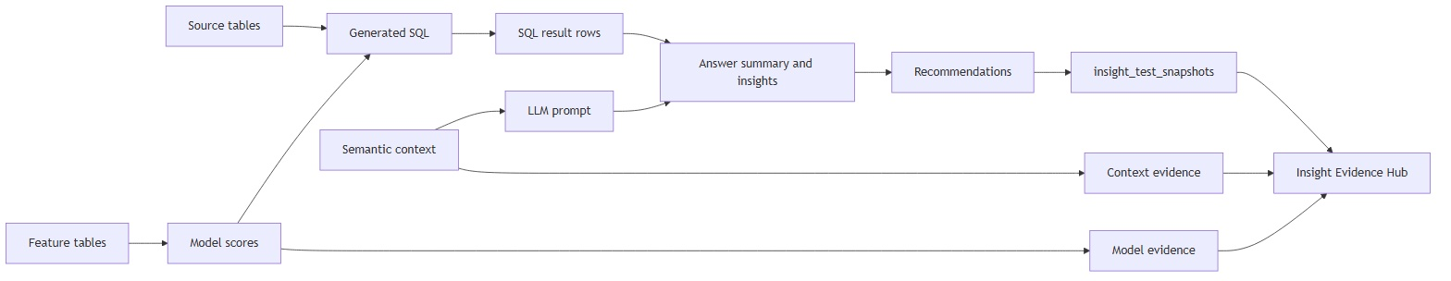
Insight Evidence Hub
Trust comes from showing the lineage from data to recommendation
Source data
Campaigns, responses, leads, policies, model scores
Generated SQL
Validated read-only query, row limits and execution status
Semantic context
KPI definitions, table meanings, join paths and model context
Business insight
Human explanation with key data points and recommendations
Client briefing | 12
Synthetic insurance data • Supabase • pgvector • Gemini / LLM • Evidence Hub
Notes:
Use this slide to show explainability. Every answer should have a trace: the source tables, generated SQL, context used, model scores, limitations and recommendation.

Slide 8
INSURANCE DECISION INTELLIGENCE PLATFORM
Data architecture
Insurance Intelligence Product
LAYERED BUILD
From synthetic data to evidence-backed AI insights
1. Generate insurance data for customers, policies, agents and campaigns
2. Load into Supabase operational tables
3. Build leakage-safe features and model scores
4. Embed semantic context in pgvector
5. Serve insights through FastAPI and React
Facts stay relational • Meaning goes vector
Client briefing | 4
Synthetic insurance data • Supabase • pgvector • Gemini / LLM • Evidence Hub
Notes:
Use this as the core build explanation. Facts are in operational tables, ML scores are in model tables, context is in pgvector, and the API connects all layers.

Slide 9
INSURANCE DECISION INTELLIGENCE PLATFORM
Campaign effectiveness walkthrough
Insurance Intelligence Product
Example business question: “Which campaign generated the highest policy conversion?”
A campaign manager needs to move from engagement metrics to business action.
1
Target
2
Respond
3
Convert
4
Score
5
Act
Customers selected for campaign
Open, click, reply or opt-in
Lead → opportunity → policy
Propensity and lead conversion
Assign leads and retarget segments
AI ANSWER SHOULD SAY
EVIDENCE BEHIND IT
The Health Protection Upgrade campaign generated the strongest conversion, driven by affluent family customers. Prioritize follow-up for engaged non-converters and assign high-propensity leads to senior agents.
campaigns, campaign_targets, campaign_responses, leads, opportunities, policies, model_scores, next_best_actions
Dashboard answers standard questions • AI answers follow-up questions
Client briefing | 10
Synthetic insurance data • Supabase • pgvector • Gemini / LLM • Evidence Hub
Notes:
Use this as the demo pivot. State the question, walk through the funnel, and then point to the evidence sources that prove the answer.

